Slide 1
Java full stack development mini project
Title-Gaming slot booking web
DONE BY
Jefferson P
43130163

Slide 2
Abstract
Java Full Stack Development involves building both the frontend and backend of web applications using Java and complementary technologies. This approach enables interactive user experiences while ensuring robust data processing and server-side logic.

Slide 3
Existing System
Traditional systems often use separate technologies for frontend (like PHP, .NET, or plain HTML/JavaScript) and backend, which can lead to complex integration and maintenance issues. Many existing solutions lack modern APIs, real-time features, or may suffer from rigidity and scalability limitations.

Slide 4
Proposed System
The proposed Java Full Stack system leverages technologies such as Spring Boot (backend), Angular/React (frontend), and MySQL (database), all tightly integrated for seamless communication and scalability. It offers security via JWT authentication and supports dynamic, responsive interfaces with robust backend processes.​

Slide 5
Advantages
Unified development stack simplifies deployment and maintenance.
Scalable architecture supporting modern UI frameworks.
Robust security features (authentication, data protection).
Better performance and real-time user experiences.
Easy integration with cloud platforms and DevOps workflows.

Slide 6
Disadvantages
Steep learning curve for mastering multiple frameworks.
Possible over-reliance on Java ecosystem and specific libraries.
Increased testing and debugging complexity due to end-to-end stack.

Slide 7
Hardware Requirements
Any modern computer (Windows/Linux/Mac) with at least 8 GB RAM and multi-core processor.
Reliable internet connection for cloud deployment and resource access.

Slide 8
Software Requirements
Java JDK (latest version)
Spring Boot framework
Node.js (for frontend build tools)
Angular or React JS (frontend)
MySQL or equivalent RDBMS
IDEs: Eclipse, IntelliJ IDEA, VS Code
Git for version control
Docker (optional, for containerization).

Slide 9
Modules
User Authentication Module
Admin Dashboard
Student/Employee Management
Attendance/Record System
Reporting/Analytics (PDF/Excel export)
REST API Integration.

Slide 10
Module Description
Authentication: Manages user registration, login, and role-based access.
Dashboard: Offers real-time data visualization and management tools.
Record Management: Facilitates CRUD operations and historical data access.
Reporting: Generates downloadable reports in multiple formats.

Slide 11
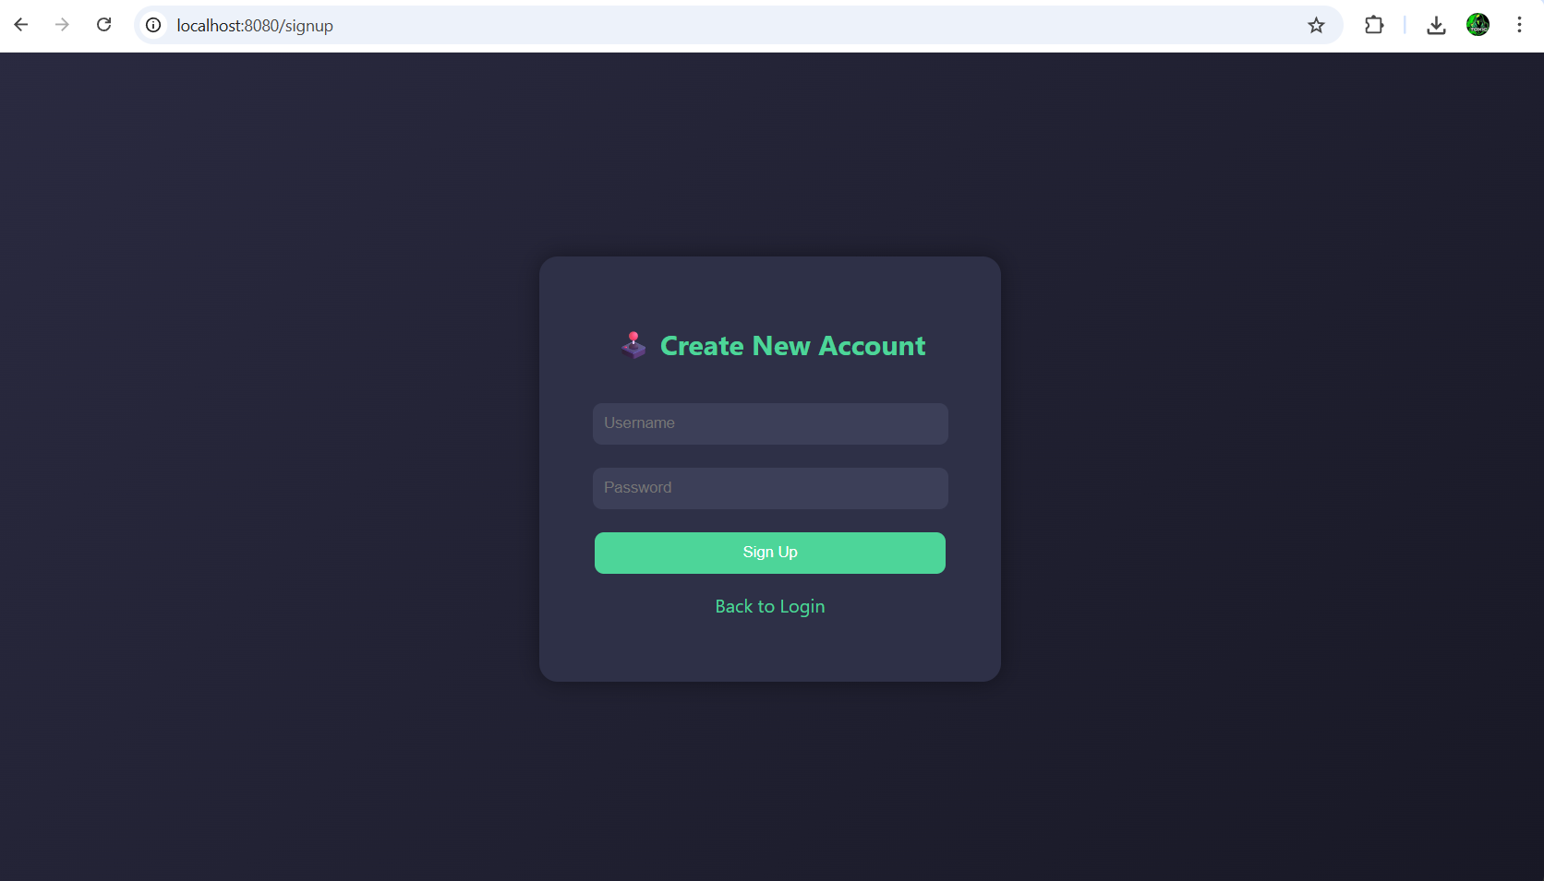
Sample Output

Slide 13
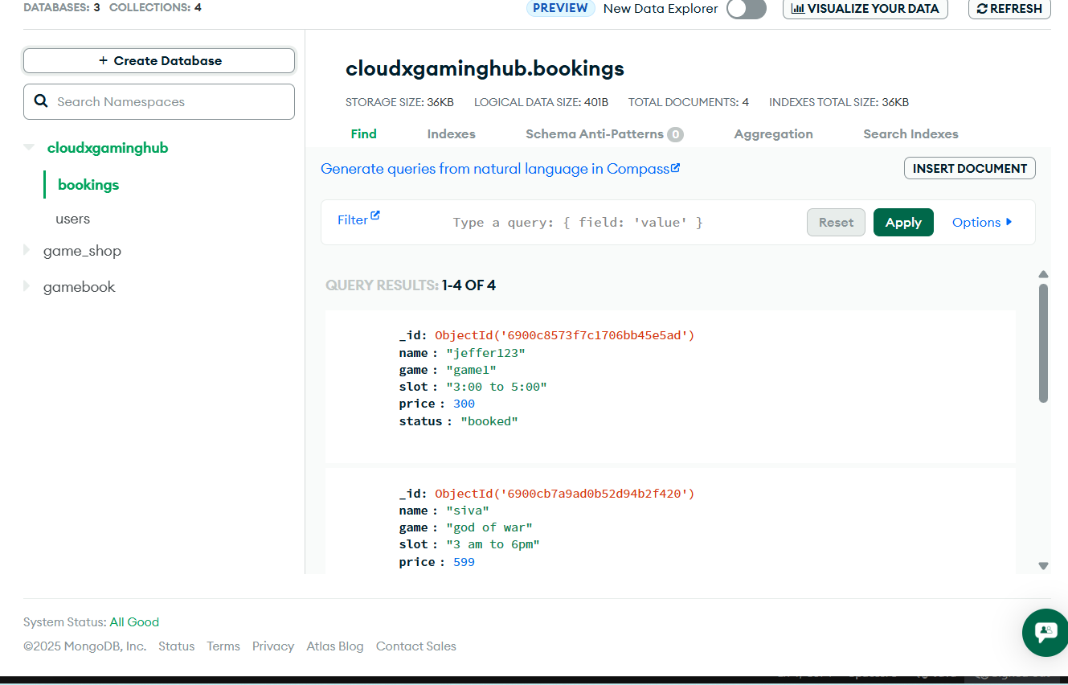

Slide 14
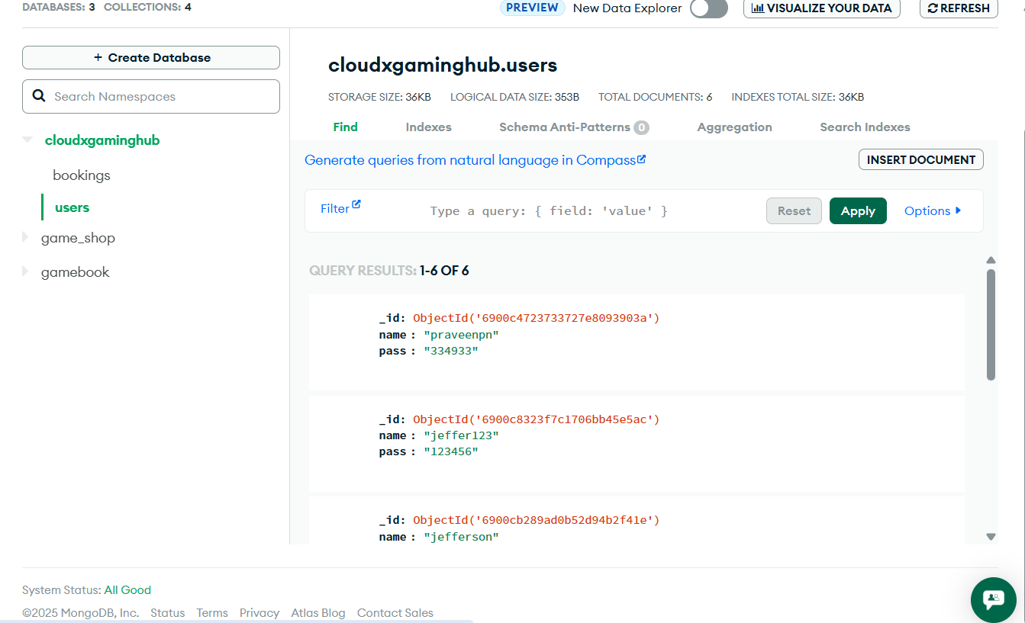

Slide 15
Conclusion
Java Full Stack Development delivers modern, scalable, and secure applications suited to today’s business and institutional requirements. Though it demands significant learning, the integrated approach ensures higher security, performance, and maintainability.

Slide 16
Thank you

